Slide 1
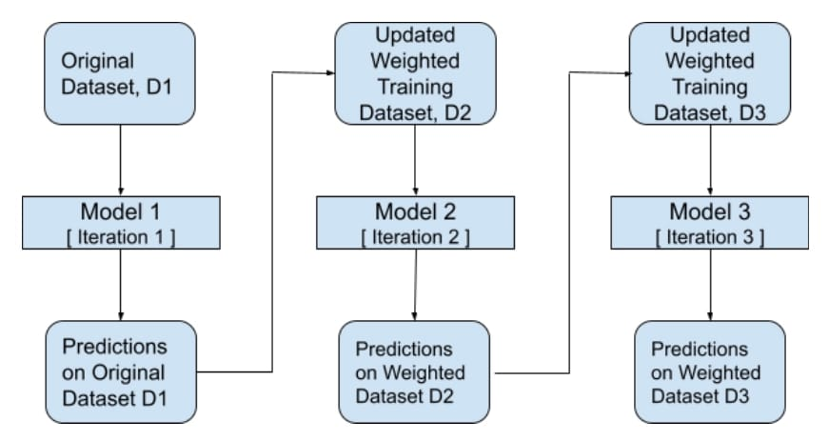
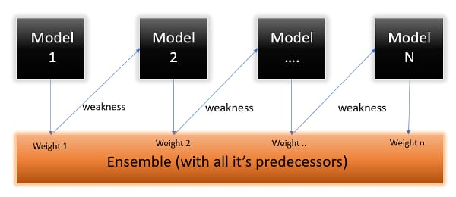
ADA BOOST ALGORITHM
AdaBoost works by putting more weight on difficult to classify instances and less on those already handled well. It is a supervised learning algorithm that is used to classify data by combining multiple weak or base learners (e.g., decision trees) into a strong learner. And it classifies data and also called as stumps where the parental node will only give leaf node
from sklearn.ensemble import AdaBoostRegressor
regressor=AdaBoostRegressor()
regressor=regressor.fit(X_train,Y_train)
R2_score:0.856

Slide 2
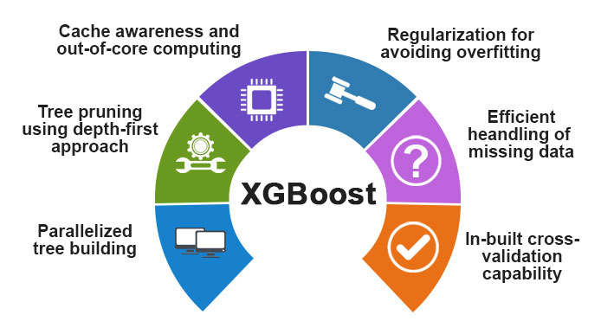

XG BOOST ALGORITHM
XGBoost is short for extreme gradient boosting. This method is based on decision trees and improves on other methods such as random forest and gradient boost. It works well with large, complicated datasets by using various optimization methods. To fit a training dataset using XGBoost, an initial prediction is made. The gradient boosting ensemble technique consists of three simple steps:An initial model F0 is defined to predict the target variable y. This model will be associated with a residual (y – F0)A new model h1 is fit to the residuals from the previous step.Now, F0 and h1 are combined to give F1, the boosted version of F0
from xgboost import XGBRegressor
regressor= XGBRegressor()
regressor=regressor.fit(X_train,Y_train)
R2_score:0.856

Slide 3
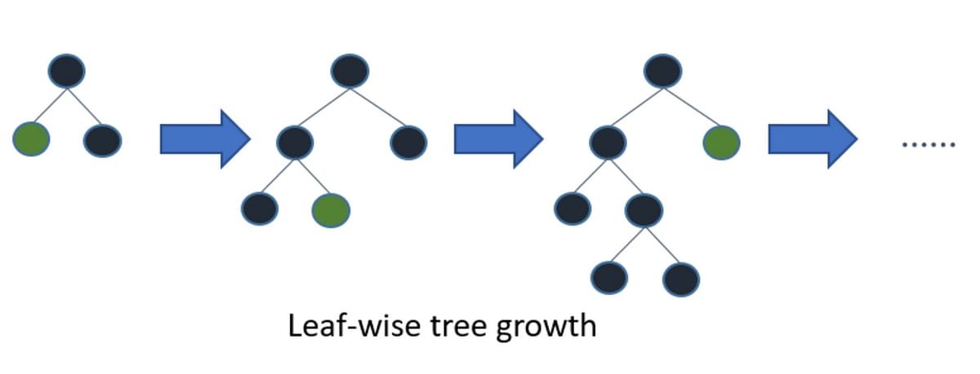
LIGHTGBM BOOSTING ALGORITHM
LightGBM is optimized for high performance with distributed systems. LightGBM creates decision trees that grow leaf wise, which means that given a condition, only a single leaf is split, depending on the gain. is an ensemble learning framework, specifically a gradient boosting method, which constructs a strong learner by sequentially adding weak learners in a gradient descent manner. It optimizes memory usage and training time with techniques like Gradient-based One-Side Sampling (GOSS). A histogram of the distribution is used by LightGBM to bucket data into bins. Instead of using every data point, the bins are used to iterate, calculate the gain, and divide the data.
Disadvantages of Light GBM: Light GBM split the tree leaf-wise which can lead to overfitting as it produces much complex trees. Compatibility with Datasets: Light GBM is sensitive to overfitting and thus can easily overfit small data.

